Slide 1
Object Oriented Programming Lecture - 5
Prof. Varsha Dange

Slide 2
Java Constructors
a constructor is a special type of method that is used to initialize instance variables in a class.
the sole purpose of the constructor is to initialize the data fields of objects in the class.
constructor within a class allows constructing the object of the class at runtime.
It is invoked when an instance of a class is created using the new operator.
Constructors can also accept arguments like methods and can be overloaded.

Slide 3
Java Constructors
Constructor’s name must be the same as the name of the class in which it is declared and defined.
The constructor should not have any return type even void also because if there is a return type then JVM would consider as a method, not a constructor.
Compiler and JVM differentiate constructor and method definitions on the basis of the return type.
Whenever we create an object/instance of a class, the constructor will be automatically called by the JVM.

Slide 4
Java Constructors
If we don’t define any constructor inside the class, Java compiler automatically creates a default constructor at compile-time and assigns default values for all variables declared in the class.
Java constructor may or may not contain parameters.
A constructor is automatically called and executed by JVM at the time of object creation.
This means that when an object of a class is created, constructor is called. When we create second object then the constructor is again called during the second time.

Slide 5
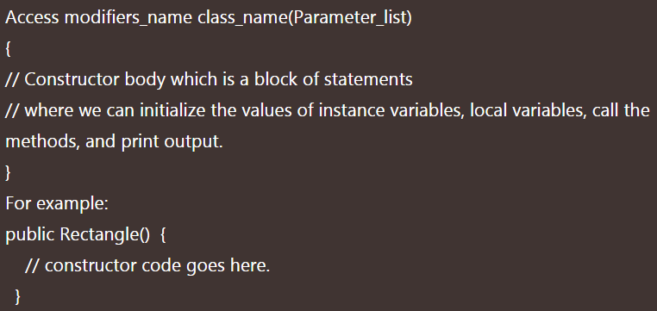
Constructor Declaration in Java

Slide 6
How to call Constructor in Java
There are the following ways to call a constructor in java.
1. A a = new A(); // Here, A is name of class. 2. new A(); // It is calling A() constructor. 3. super(); 4. this();

Slide 7
Types of Constructors in Java
there are two types of constructors in java. They are as:
Default Constructor (No-argument constructor)
Parameterized Constructor (Argument constructor)

Slide 8
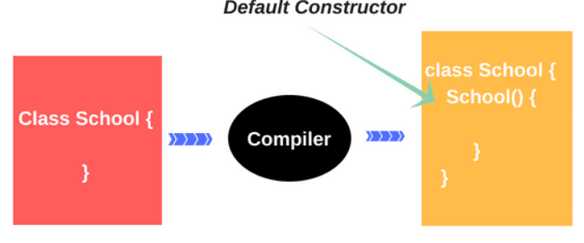
Default Constructor
A constructor that has no parameter is known as default constructor in Java.
Java compiler automatically creates a default constructor (Constructor with no arguments) in case no constructor is present in the java class. Following are the motive behind a default constructor.
Create the Object
Call the super class constructor()
Initialize all the instance variables of the class object.
We cannot pass any argument to default constructor.
It does not do anything but it allows to create instance of class. Example

Slide 9
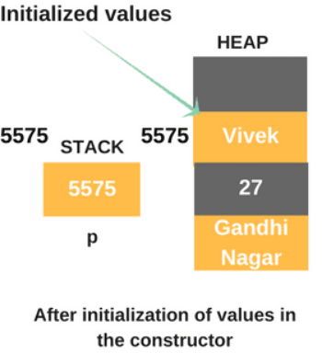
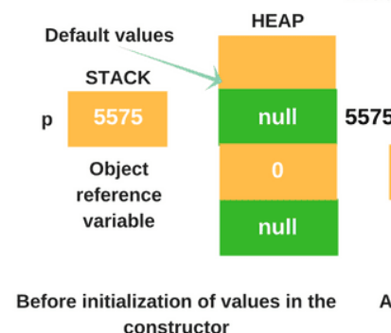

Default Constructor
The below figure will show how to initialize values of variables inside the memory location.

Slide 10
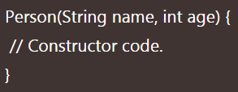
Parameterized Constructor
A constructor that takes 1 or more parameters is known as parameterized constructor in java.
The parameterized constructor is used to provide different values to distinct objects.
To call the parameterized constructor, we pass arguments while creating the object.
parameterized constructor is also called argument constructor.
We cannot define two constructors with the same number of parameters and the same types.
Example1
Example2

Slide 11
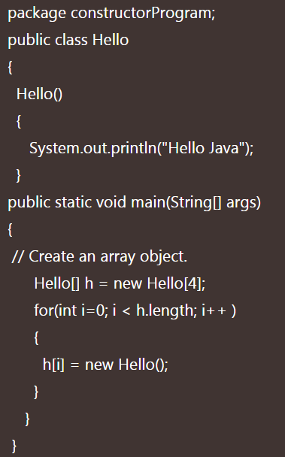

Constructor with Array of Objects

Slide 12
Difference between Constructor and Method
SN | Constructor | Method
1. | Constructor is a special type of method that is used to initialize the state of an object. | Method is used to expose the behaviour of an object.
2. | It has no return type even void also. | It has both void and return type.
3. | If we don’t provide any constructor in the class, Java Compiler provides a default constructor for that class. | Method is not provided by the compiler in any case.
4. | Constructor name must be the same as name of the class. | Method name may or may not be the same name as the class name.
5. | The purpose of a constructor is to create an object of a class. | The purpose of a method is to execute the functionality of the application.
6. | They are not inherited by subclasses. | They are inherited by subclasses.

Slide 13
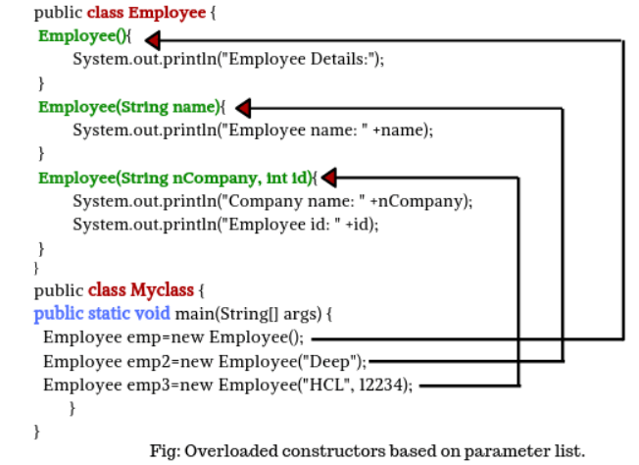
Constructor overloading
Java constructor overloading helps to achieve static polymorphism.
Example

